Slide 1
On Sufficient and Necessary Conditions in Bounded CTL
Renyan Feng
Guizhou University & Vrije University Amsterdam
Authors: Renyan Feng, Erman Acar, Stefan Schlobach, Yisong Wang

Slide 2
Overview
Motivation
CTL
CTL
V-bisimulation
characterizing formula
Forgetting
Definition
Properties
Complexity Results
SNC and WSC
Contributions and Thanks

Slide 3
Motivation
Removing the obsolete imformation without altering the relevant system behaviour:
Compute the Strongest Necessary Condition (SNC) and the Weakest Sufficient Condition (WSC) of a specification under a given Transition system and over a given signature.

Slide 4
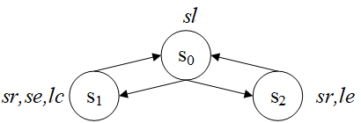
Example
Model Structure M:
Car Engine Manufacturing Scenario:
Sedan car: safety restriction, small engine, low-carbon emission
Sports car: safety restriction, large engine
Sedan car: safety restriction, small engine, low-carbon emission
Sports car: safety restriction, large engine
P={sl,sr,se,le,lc}
obsolete
New engine technology:
the company aims to adapt the sedan production to electrical engines.

Slide 5
CTL
Stands for Computation Tree Logic
Consider this Kripke structure (labeling omitted) :
the computation tree of 0 with depth 2:
M1 :
0
0
depth:0
depth:1
0
1
2
0
1
2
. . .
1

Slide 6
CTL
Informally, CTL is interpreted over Kripke Structures.
We have path quantifiers :
A ... : holds for all path (starting at the tree’s root)
E ... : holds for some path
Temporal operators :
X ... : holds next time
F ... : holds in the future
G ... : always hold
U : until
ϕ ::= p // atomic (state) proposition: Prop | ¬ϕ | ϕ₁ ∧ ϕ₂ | EX ϕ | EG ϕ | E(ϕ₁ U ϕ₂)
Notes:
M would only have one computation tree if it only has 1x innitial states; else it can have multiple comp. trees. Of course, each computation tree can be inifitely deep.

Slide 7
Semantics
: transition relation : label function
S: a finite set of states
s₀: an initial state in S
Let M = ( S, R, L, s₀) be an initial structure ☺
M,t ⊨ ϕ ϕ holds on the sate t
Which is recursively defined as follows:
M,t ⊨ p iff p ∈ L(t)
M,t ⊨ ¬ϕ iff not ( M,t ⊨ ϕ )
M,t ⊨ ϕ∧ψ iff M,t ⊨ ϕ and M,t ⊨ ψ
is a Kripke structure (S,R,L) with initial state

Slide 8
M,t ⊨ EXϕ iff ( ∃(t,v)∈ R :: M,v ⊨ ϕ )
M,t ⊨ EGϕ iff
There is a path σ in M, starting at t such that:
For all i≥0, M, σ_{i} ⊨ ϕ
M,t ⊨ E[ ψ U ϕ ] iff There is a path σ in M, starting at t such that:
For some i≥0, M, σ_{i} ⊨ ϕ
For all previous j, 0≤j<i, M, σ_{j} ⊨ ψ

Slide 9
Bounded CTL
The size of CTL formula is bounded to n.
It will be sufficient to consider the models of formulas within a state space S satisfying .

Slide 10
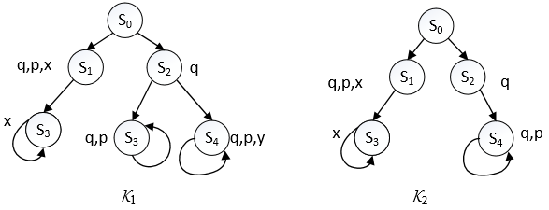
V-bisimilar
Two V-bisimilar initial K-structures, V={y}.
P={p,q,x,y}
{y}-bisimilar
We use these V-bisimulation also for computation trees.
They are behaviourally the same on P\{y}.

Slide 11

Example
Two states s and s' in M are V-distinguishable, if there exists
a least constant k such that , denoted as

Slide 12
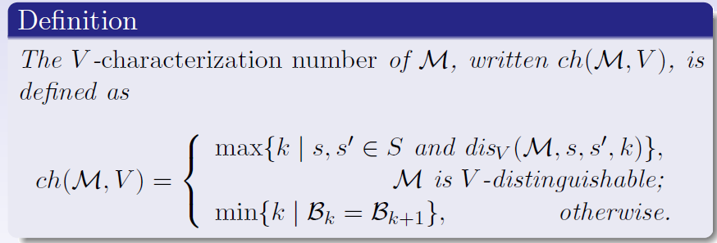
V -characterization number
We can see that ch(M,V) always exists for every initial structure M and V.

Slide 13
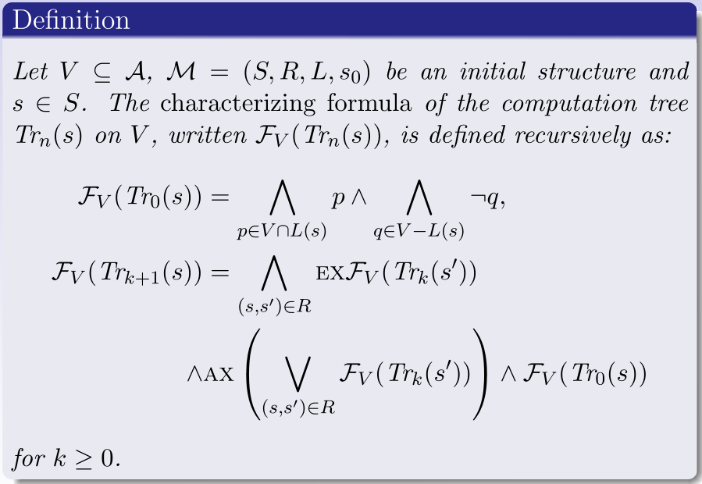
Characterizing formula - computation tree

Slide 14
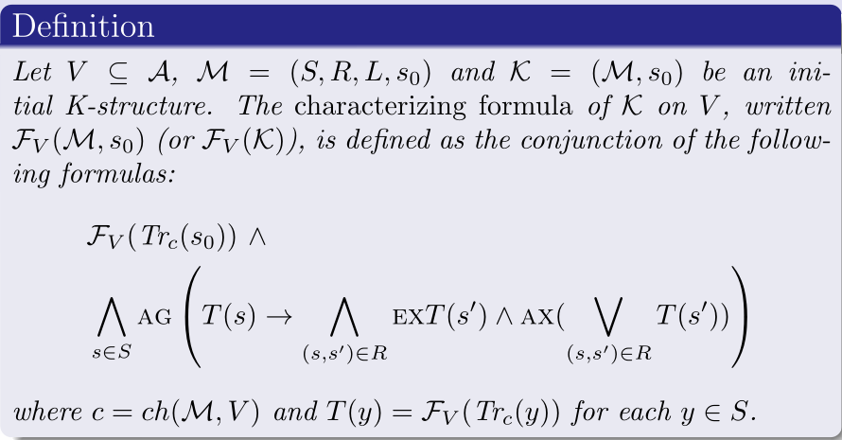
Characterizing formula - initial K-structure

Slide 15
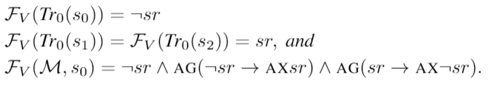
Example

Slide 16
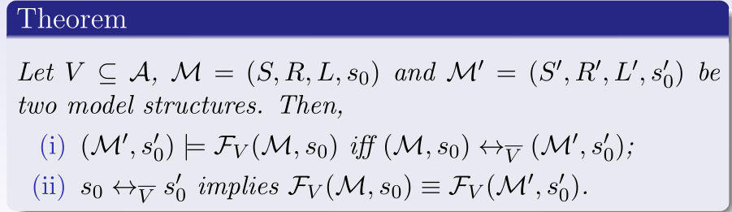
Important results

Slide 17
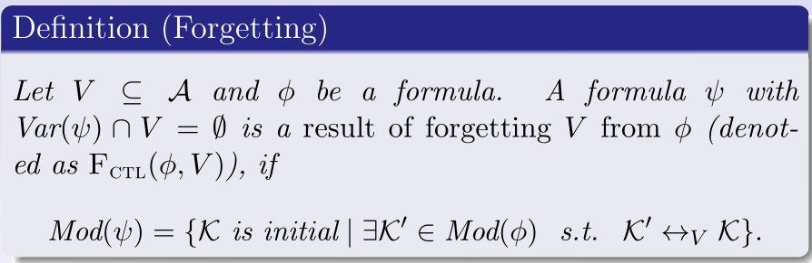

Forgetting
Such a formula always exists, which is equivalent to

Slide 18
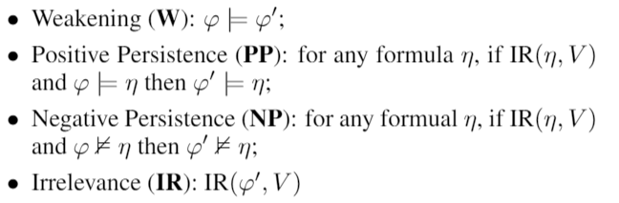
Important postulates in Forgetting
IR( ,V) means that there exists a CTL formula such that and do not contain any atoms in V.
Yan Zhang and Yi Zhou. Knowledge forgetting: Properties and applications. Artificial Intelligence, 173(16-17):1525–1537, 2009.

Slide 19
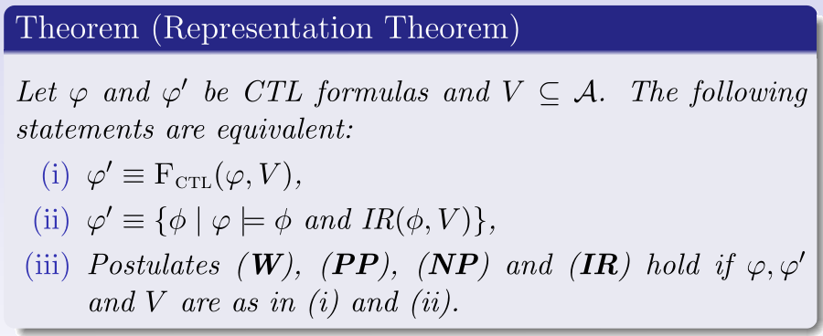
Representation Theorem

Slide 20
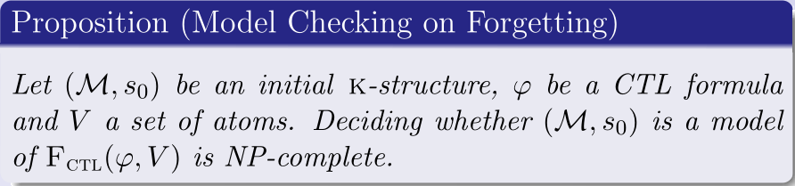
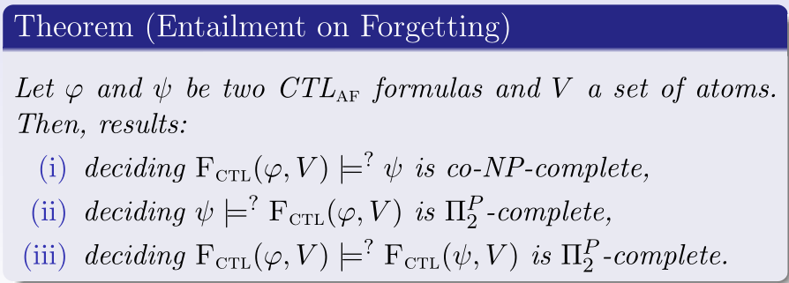
Complexity Results

Slide 21
SNC and WSC
Two logical notions introduced by the Dutch computer scientist Edgar Dijkstra are informative:
Strongest Necessary Condition (SNC) is the most general consequence；and
Weakest Sufficient Condition (WSC) is the most specific abduction

Slide 22
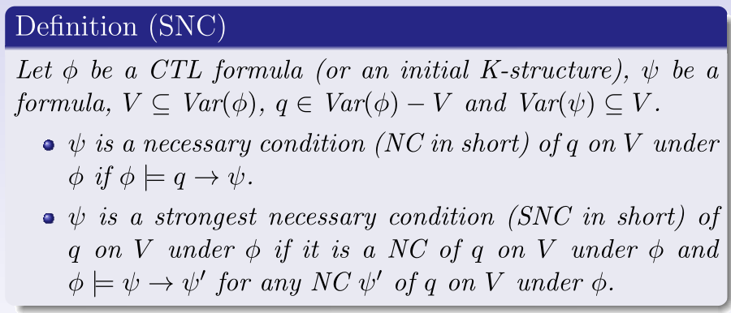
Strongest Necessary Condition
Strongest Necessary Condition (SNC) is the most general consequence

Slide 23
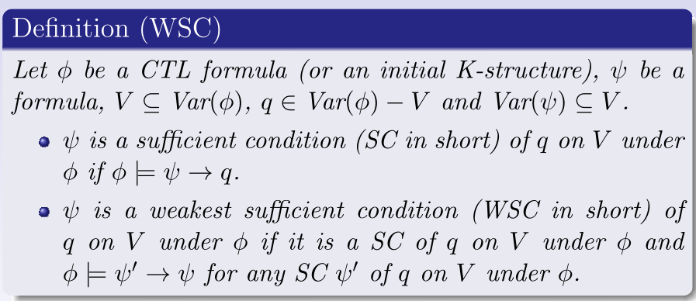
Weakest Sufficient Condition
Weakest Sufficient Condition (WSC) is the most specific abduction

Slide 24
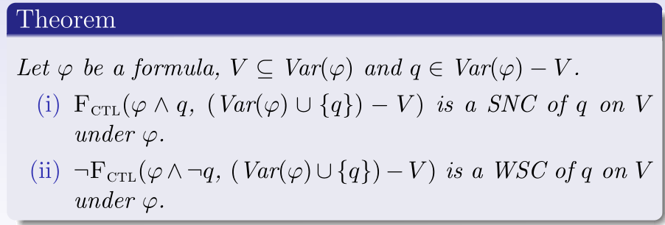
The relationship - SNC (WSC) and Forgetting
Dual
SNC
WSC

Slide 25
Contributions
A Forgetting framework for CTL
Representation Theorem
Complexity results
Algebraic Properties of the Forgetting operator: Homogeneity, Commutativity, and others
Computing SNC and WSC by using Forgetting in CTL

Slide 26
Conclusion
A Forgetting framework for CTL
Representation Theorem
Complexity results
Algebraic Properties of the Forgetting operator: Homogeneity, Commutativity, and others
Computing SNC and WSC by using Forgetting in CTL
Future work:
Implement our method
Do some experments

Slide 27
Thanks!

